Slide 1
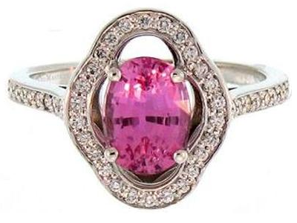
Production Line Analysis - Rings
Colormasters Precious Jewelry
Jason Heller

Slide 2

Data Cleaning and Aggregation
Contents
Colormasters collected ring manufacturing data from 2022 to 2023
Method
Omitted locations unrelated to ring manufacturing
Excluded production time in final location (not bounded by an end date)
Challenges
Some ring visited locations unrelated to ring manufacturing (ex: adding findings to a piece)
Potential mislabeling of piece locations possible
Not all locations are internal

Slide 3

Questions to Address
Which processes are slowing down manufacturing time?
Are there any problems with the current procedures?
What changes could be implemented to improve manufacturing lead time?

Slide 4
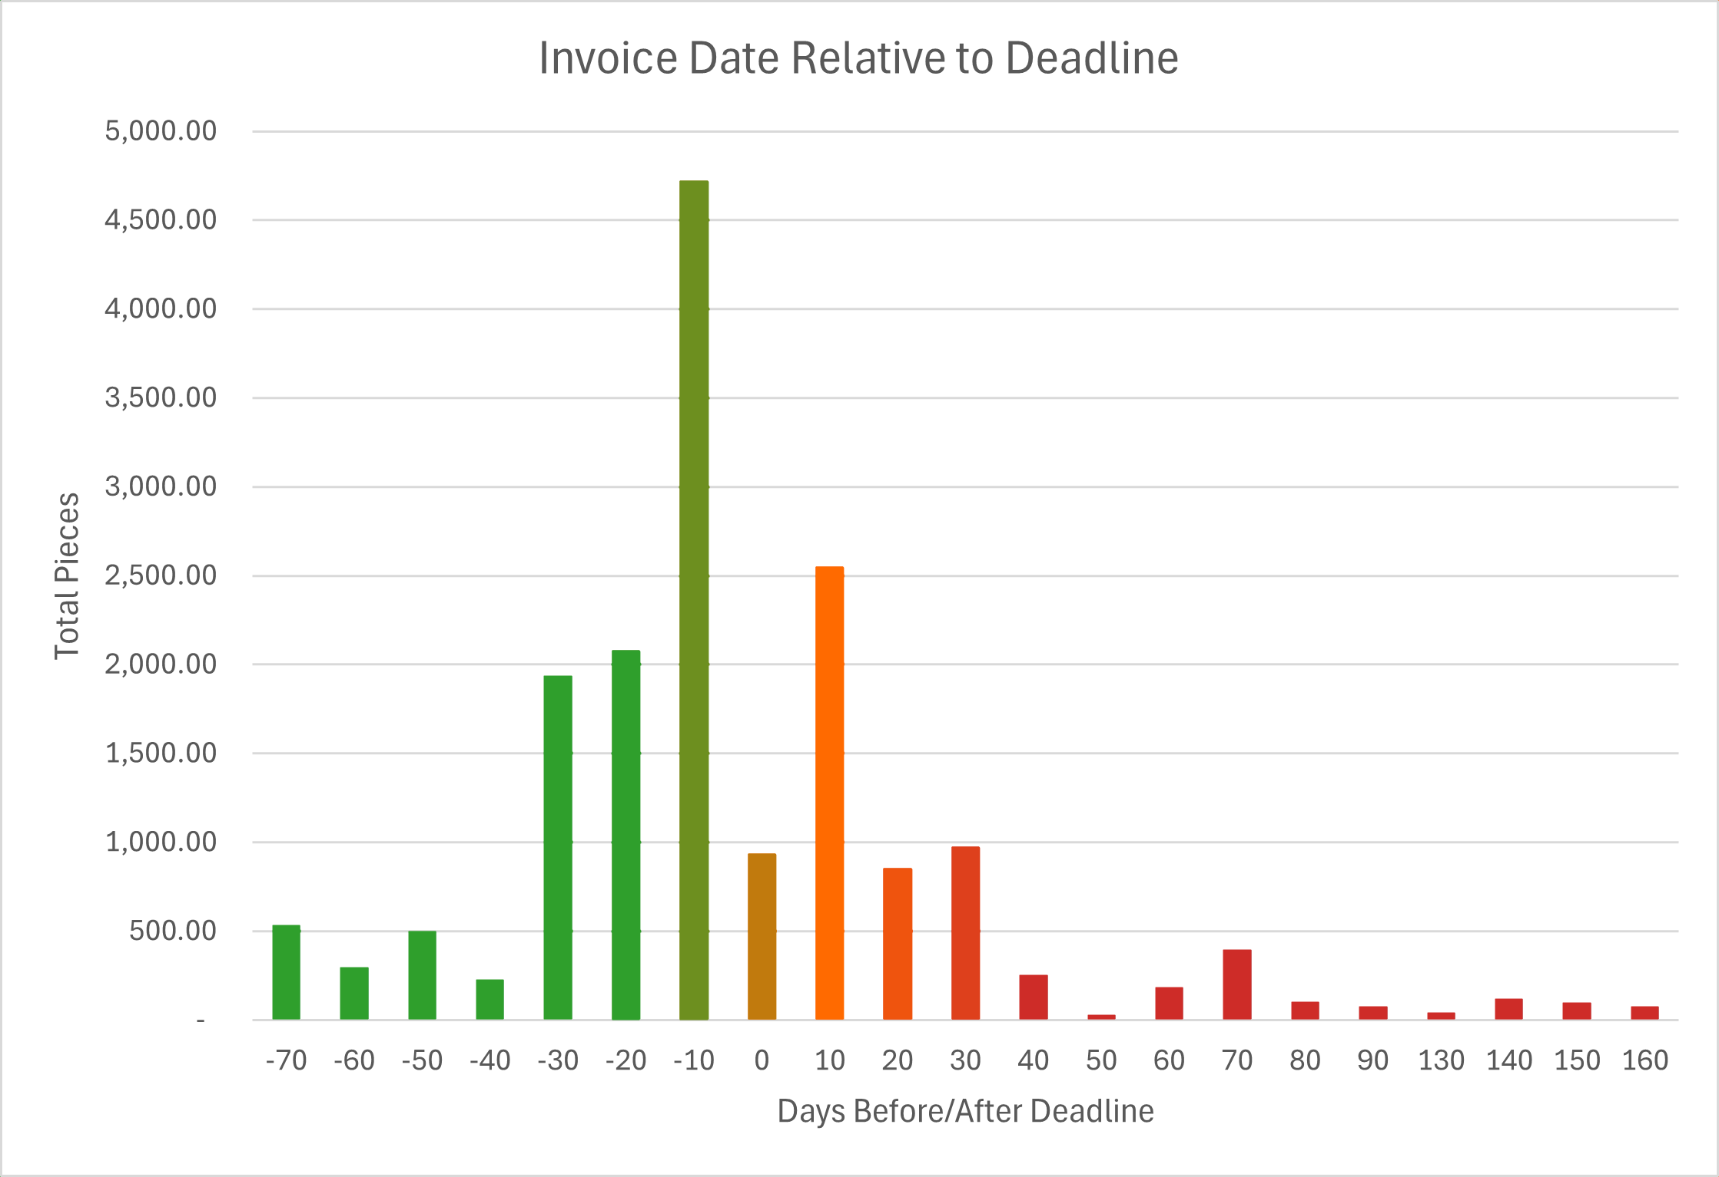
Most overdue items fall near due date
Outliers with long overdue dates create a rightward tail in the distribution

Slide 5

Observations of Shank Size

Slide 6
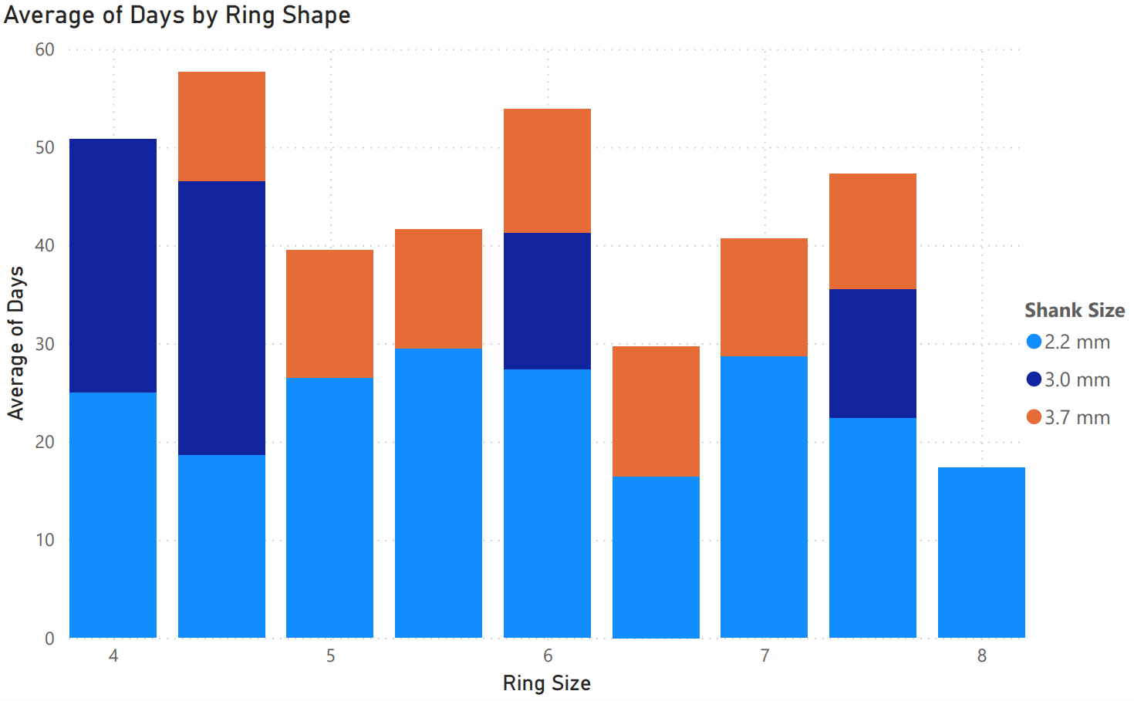
Smaller shank sizes lead to higher average time to manufacture

Slide 7
Observations of Volume Over Time

Slide 8
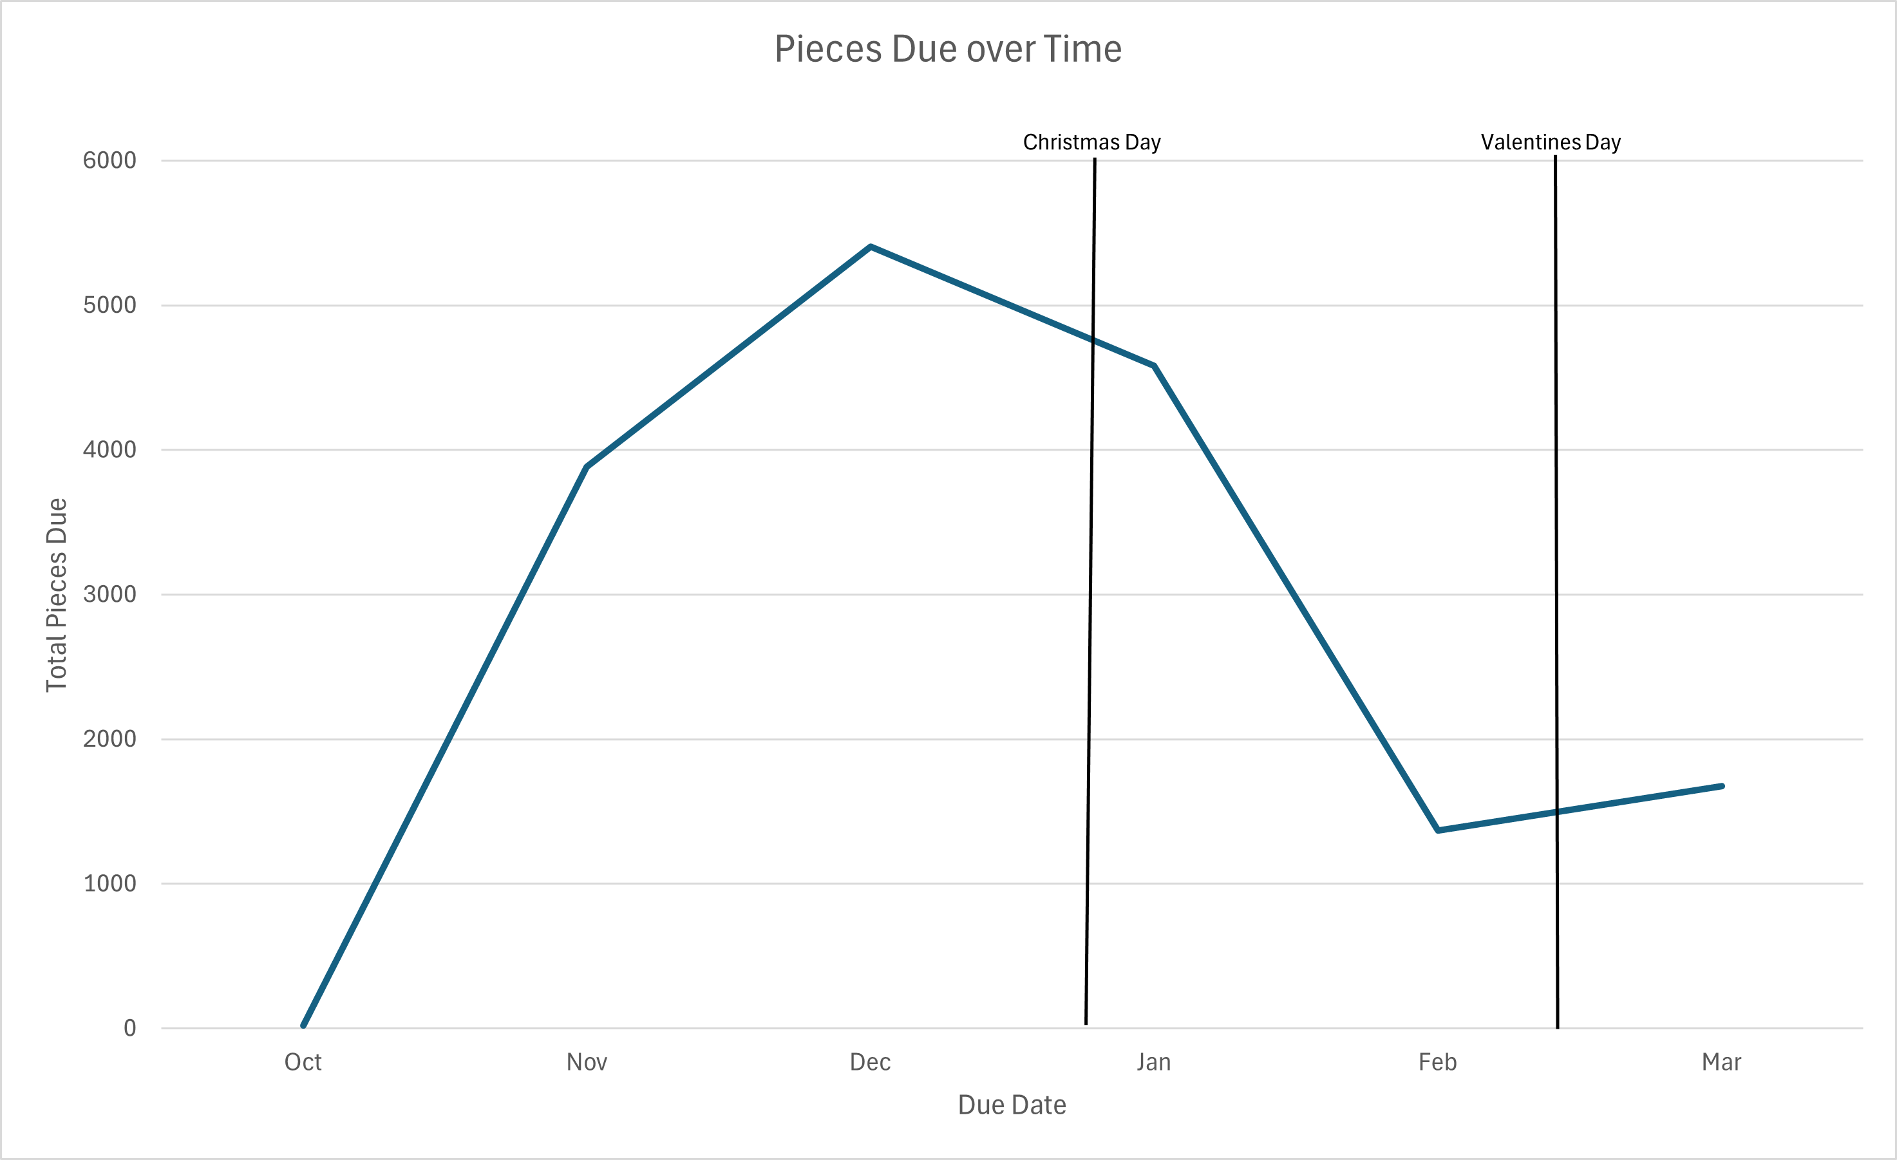
Christmas and Valentine's Day are some of the busiest times in the jewelry industry. We can see a spike in the number of pieces due just before these holidays are observed.

Slide 9
Observations of Factory Locations

Slide 10
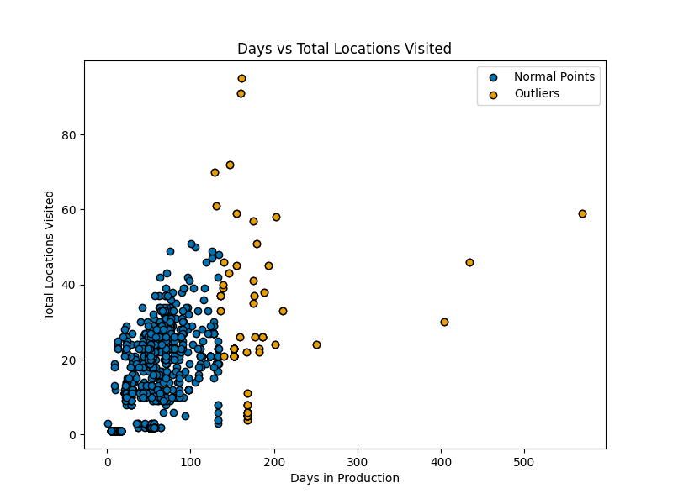
Items with more locations visited do not necessarily have longer production times.
While the extreme values can have significantly more locations visited, it is not the root cause of their longer production timespan

Slide 11
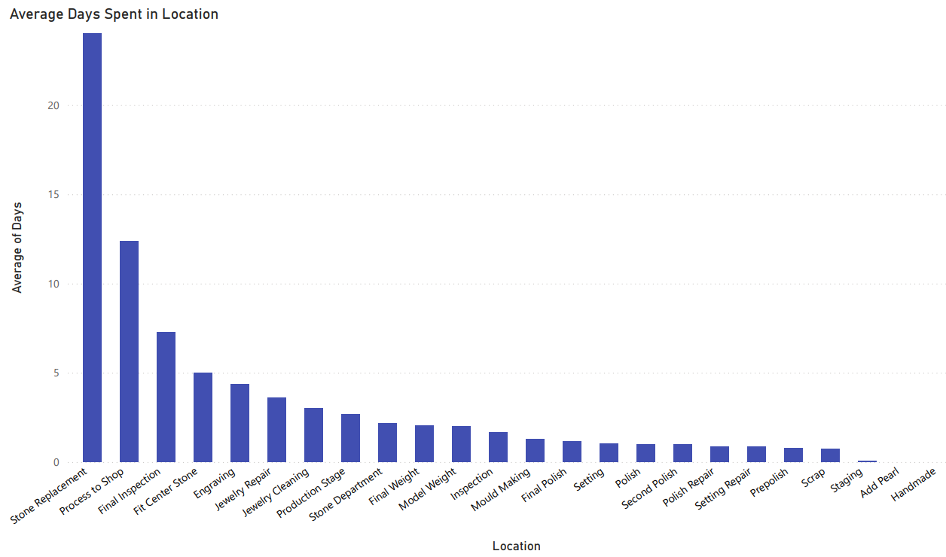

Slide 12
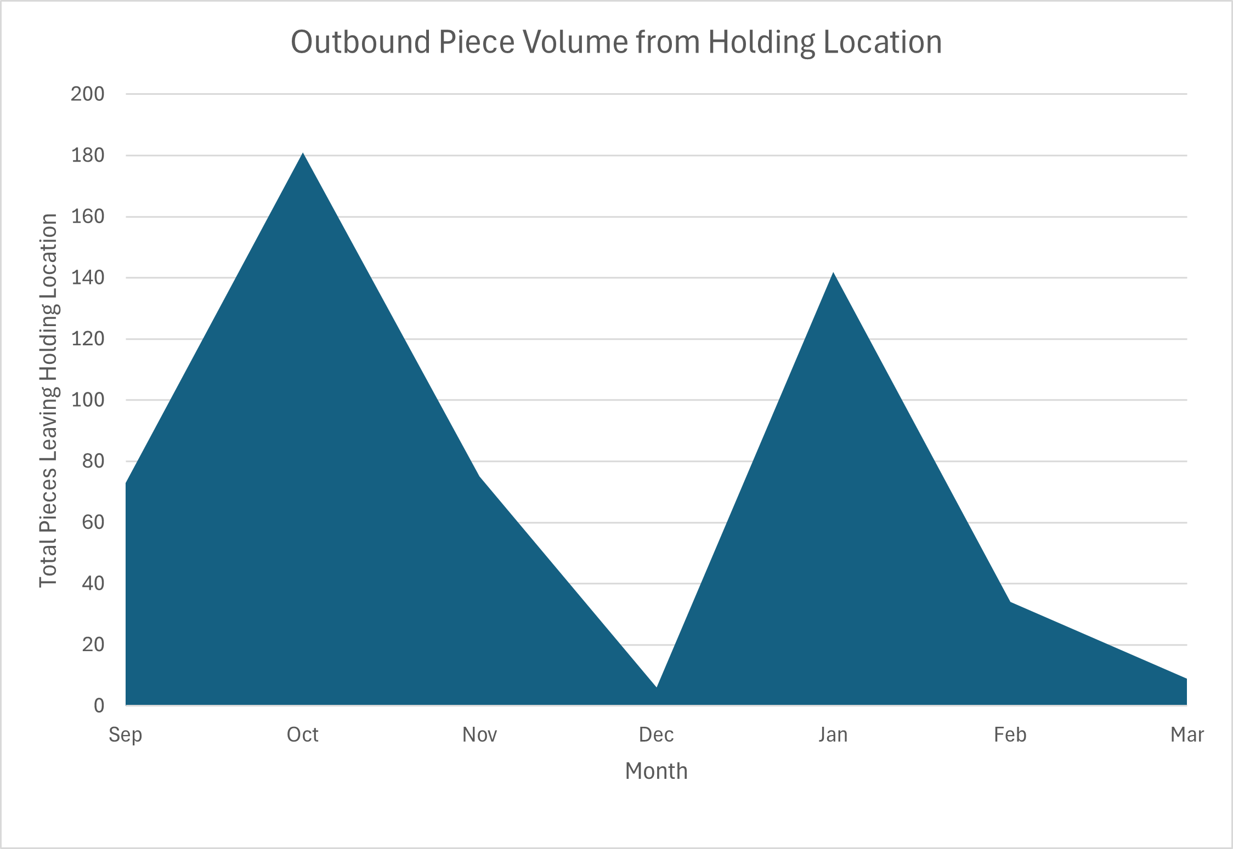
Items stay in a holding location until they are ready to be passed off to a jeweler
We see that this location has a spike in outbound volume near the holidays

Slide 13

Bottlenecks Found
The Process to Shop holding location tends to have items sit in it for extended periods of time, waiting for a Jeweler to take the job
The Stone Replacement location takes long due to the need to source a new stone
Items tend to take longer in Final Inspection – this is likely a data recording errors for jobs that fail inspection
The high volume caused by the Holidays slows down production overall

Slide 14

Recommendations
Stock common stones shapes/sizes for use in common repairs to bring down stone replacement time
Create stock rings before October to prepare for holiday volume spike
Bring on more jewelers/setters/QC to move pieces out of the holding location and into production faster

